Slide 1
Monitored Buses and Phases InvControl2 and PVSystem2
OpenDSS: Version 8.6.6.1 (64-bit build)
Authors: Paulo Radatz and Celso Rocha

Slide 2
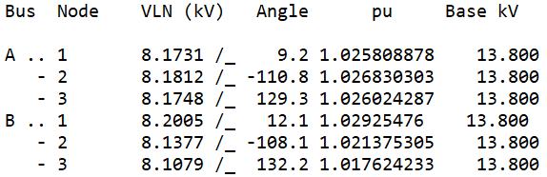
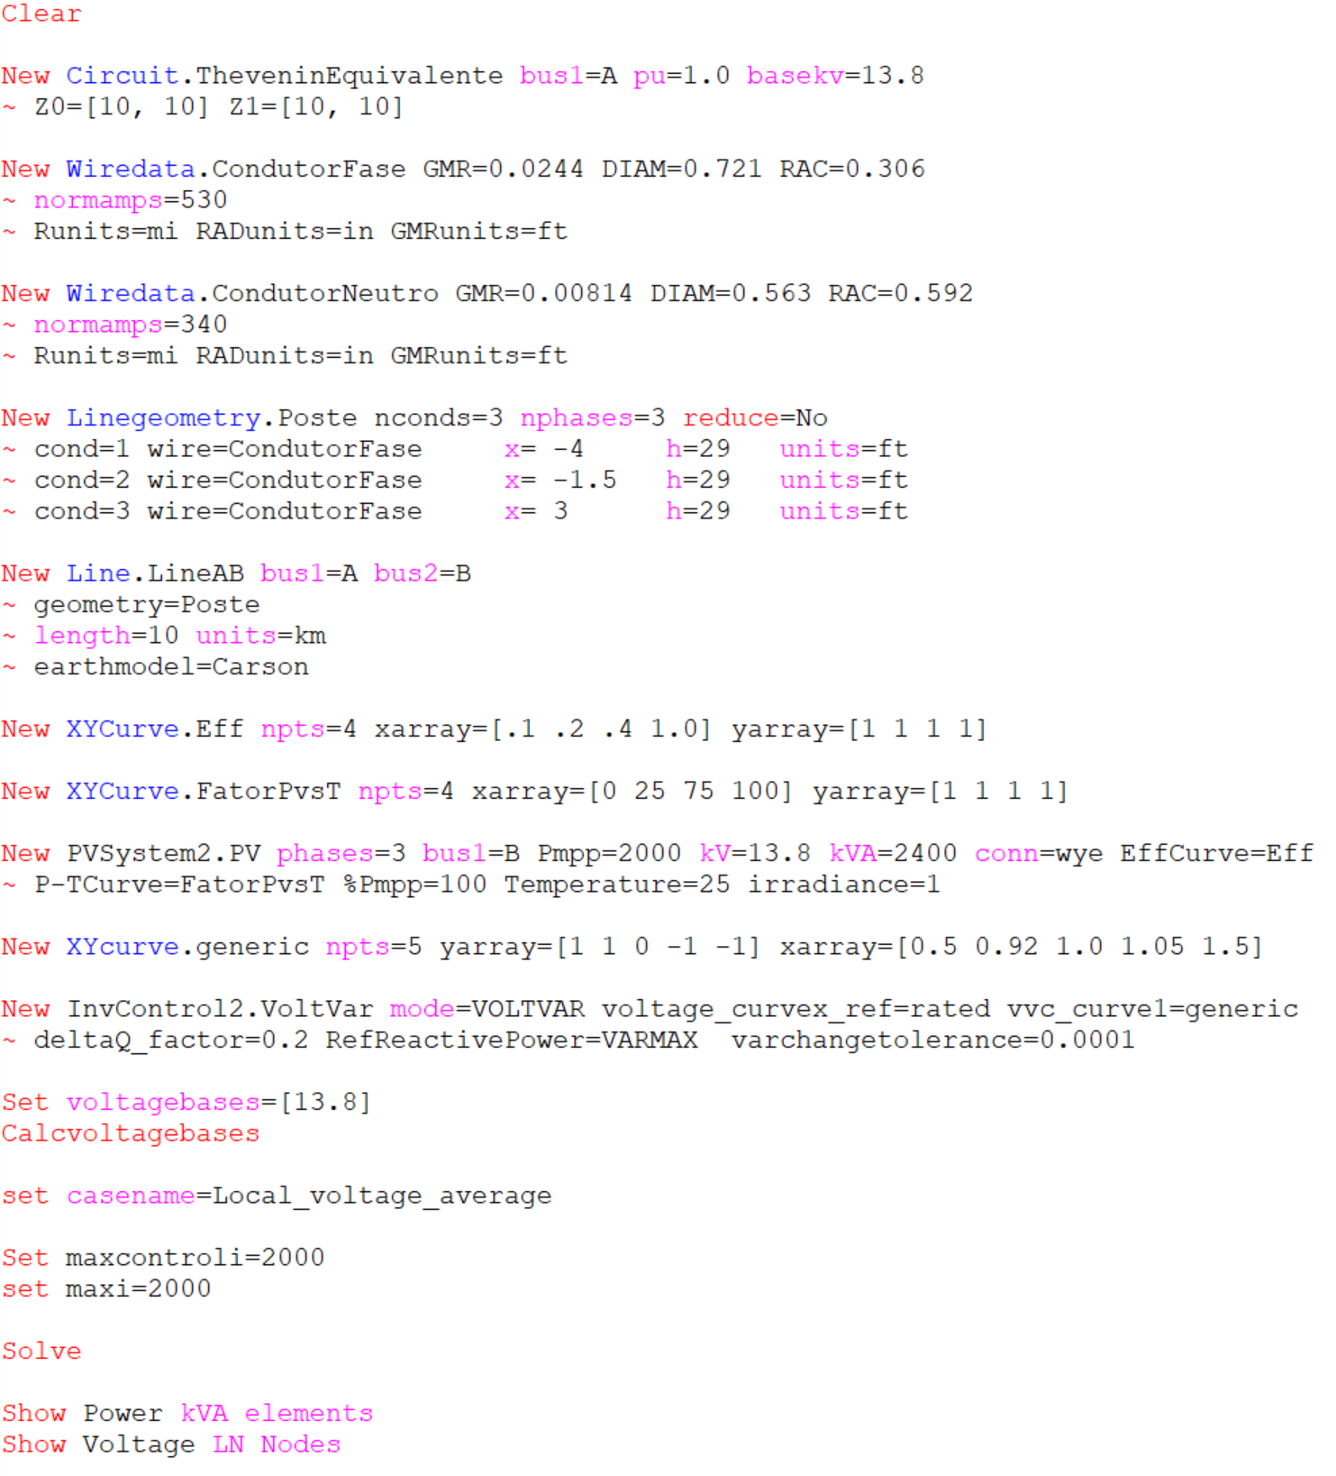
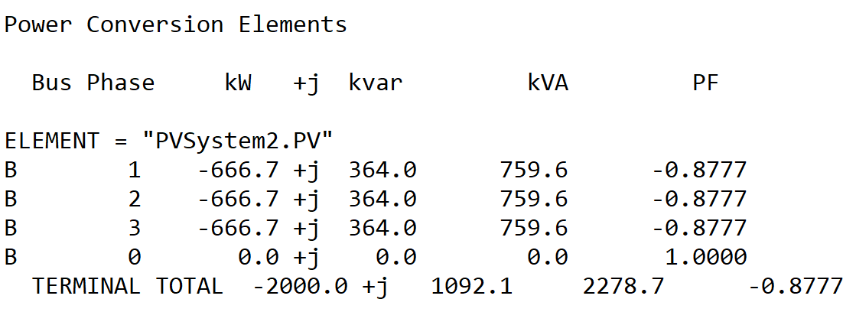
Scenario 1: PVSystem2’s bus is Monitored for volt-var. Average Voltage (default mode)
OpenDSS code (Local_voltage_average-2.dss)
Vpu = Vpu_average = 1.022751433
Volt-var equation
Q= (-20 x Vpu +20) x kvarlimit = -1092.068
Kvarlimit=kVA=2400

Slide 3
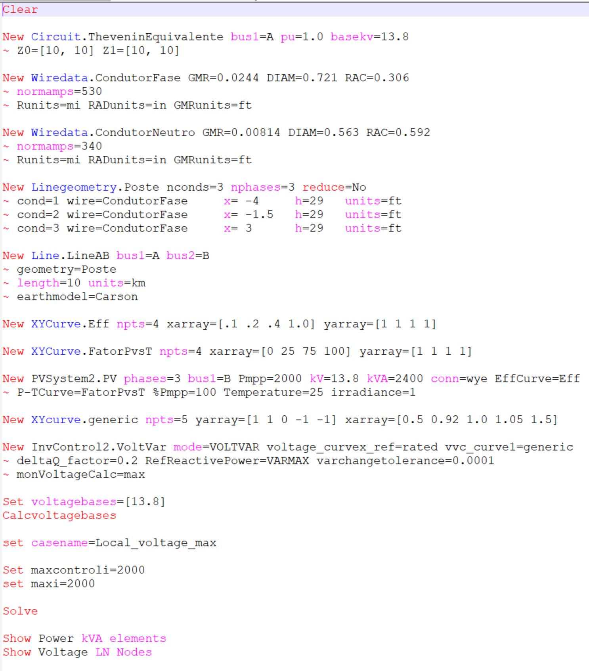
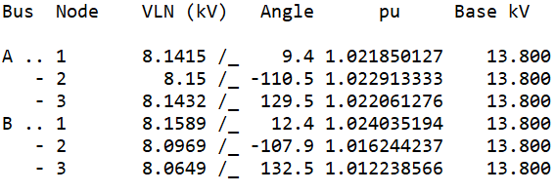
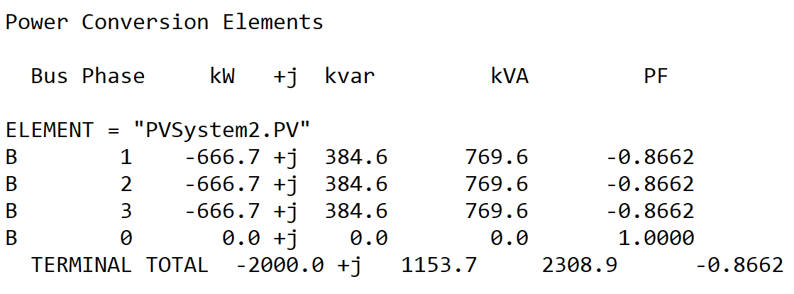
Scenario 2: PVSystem2’s bus is Monitored for volt-var. Max Voltage
OpenDSS code (Local_voltage_max-2.dss)
Vpu = Vpu_max = 1.024035194
Volt-var equation
Q= (-20 x Vpu +20) x kvarlimit = -1153.689
Kvarlimit=kVA=2400

Slide 4
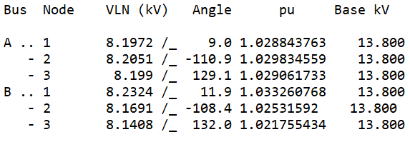
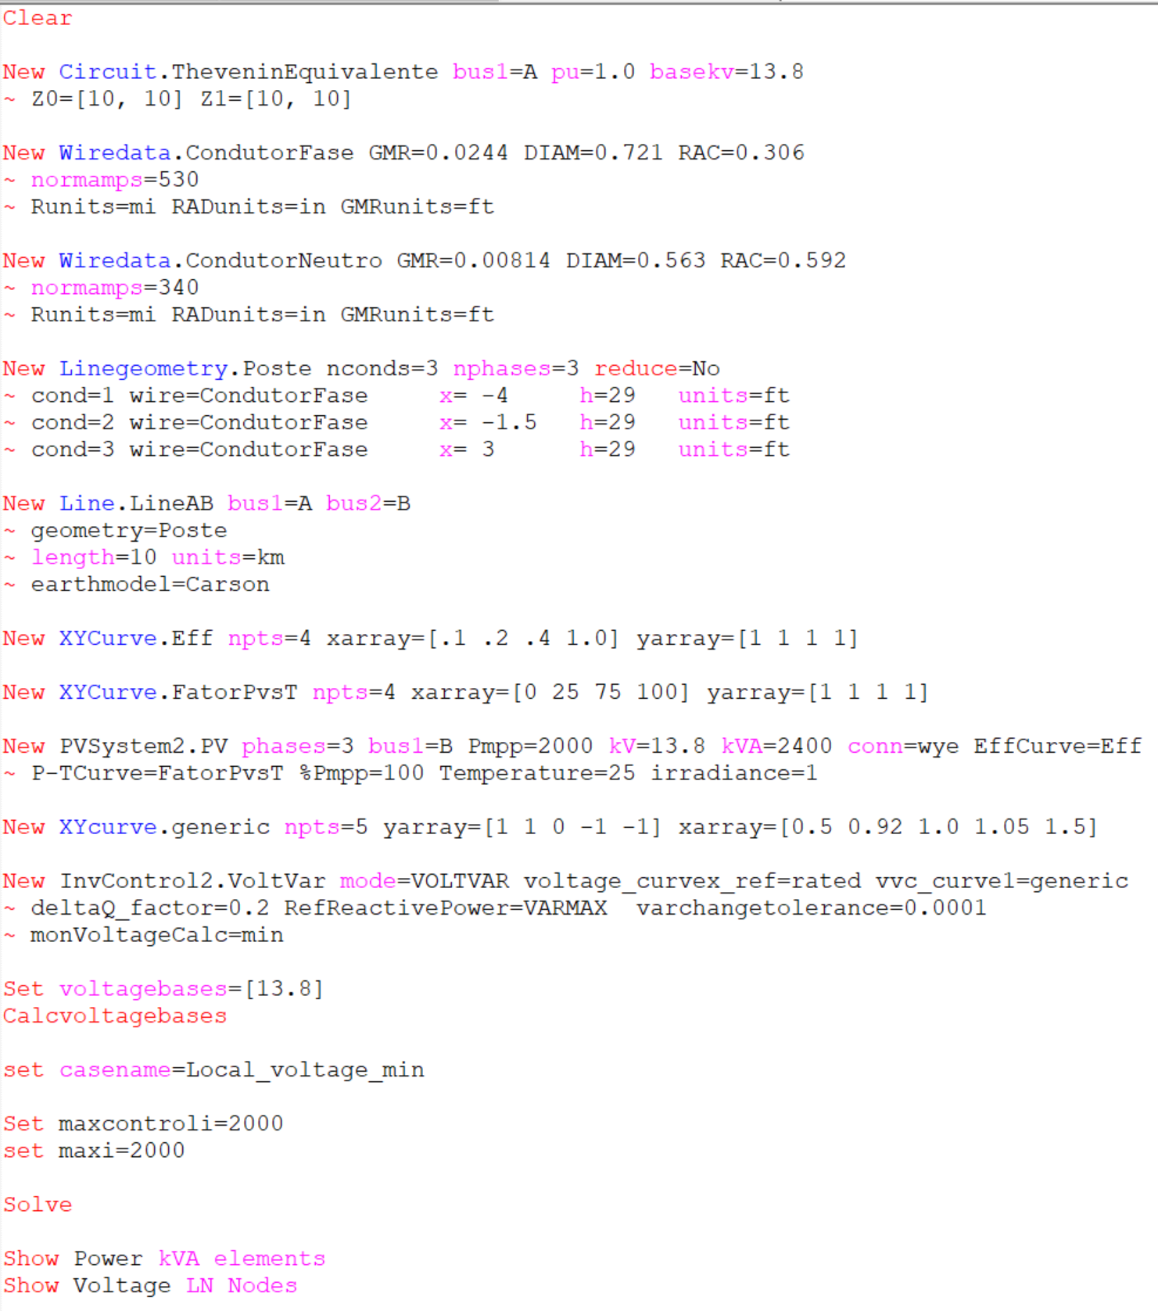
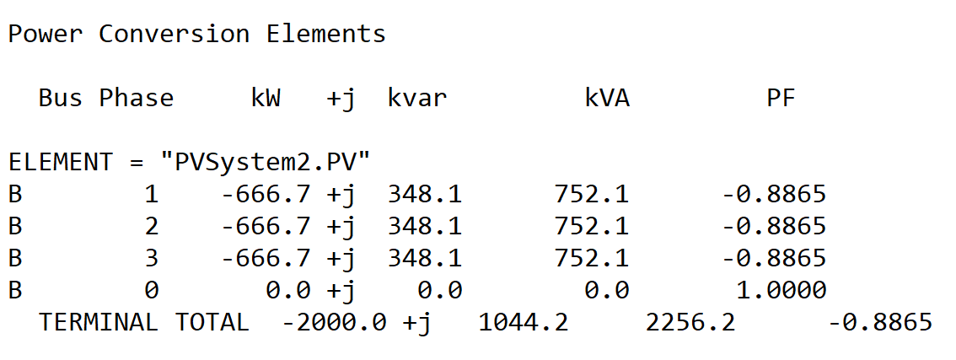
Scenario 3: PVSystem2’s bus is Monitored for volt-var. Min Voltage
OpenDSS code (Local_voltage_min-2.dss)
Vpu = Vpu_min = 1.021755434
Volt-var equation
Q= (-20 x Vpu +20) x kvarlimit = -1044.26
Kvarlimit=kVA=2400

Slide 5
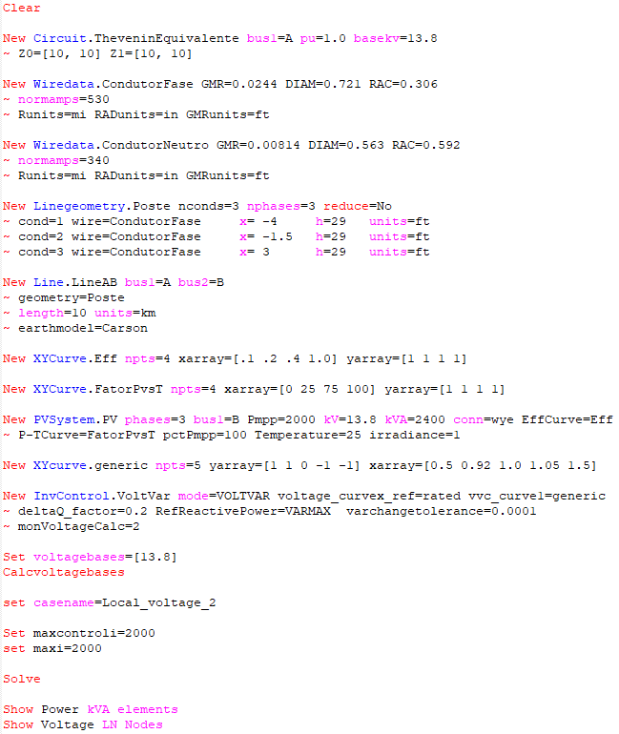
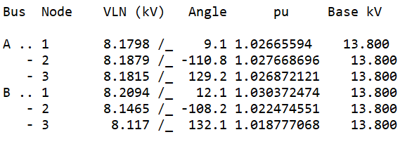
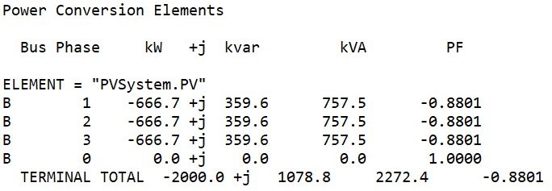
Scenario 4: PVSystem2’s bus is Monitored for volt-var. Phase 2 Voltage
OpenDSS code (Local_voltage_2.dss)
Vpu = Vpu_2 = 1.022474551
Volt-var equation
Q= (-20 x Vpu +20) x kvarlimit = -1078.778
Kvarlimit=kVA=2400

Slide 6
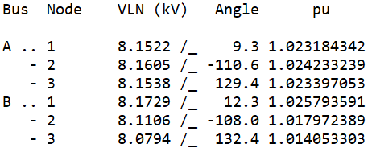
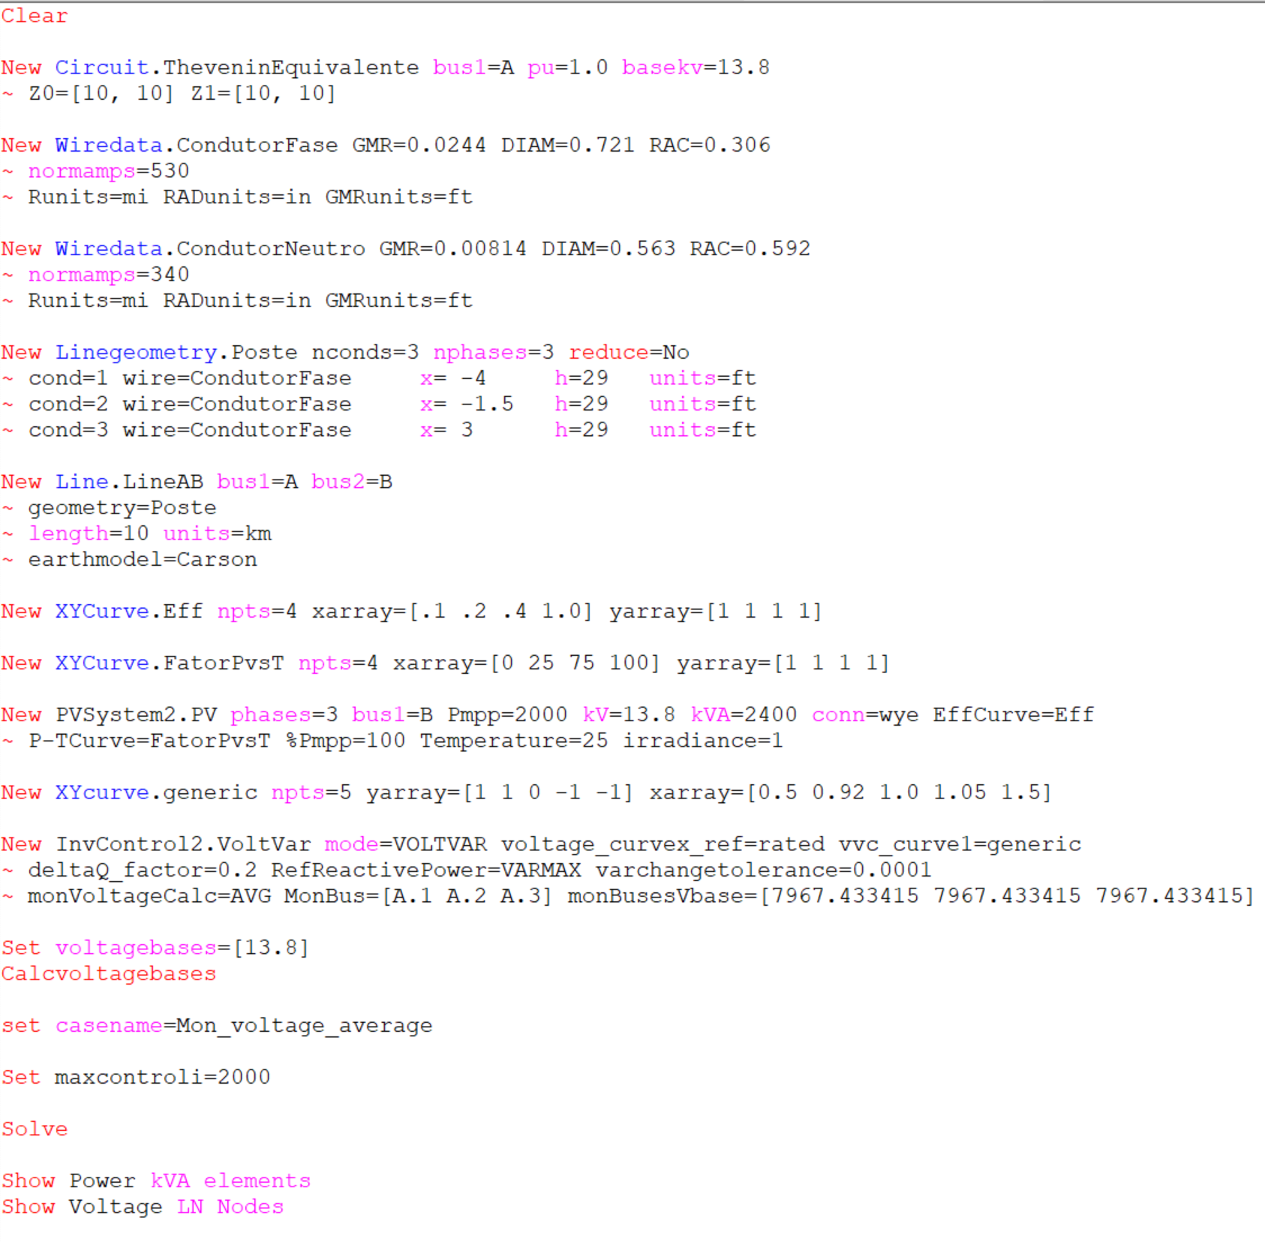
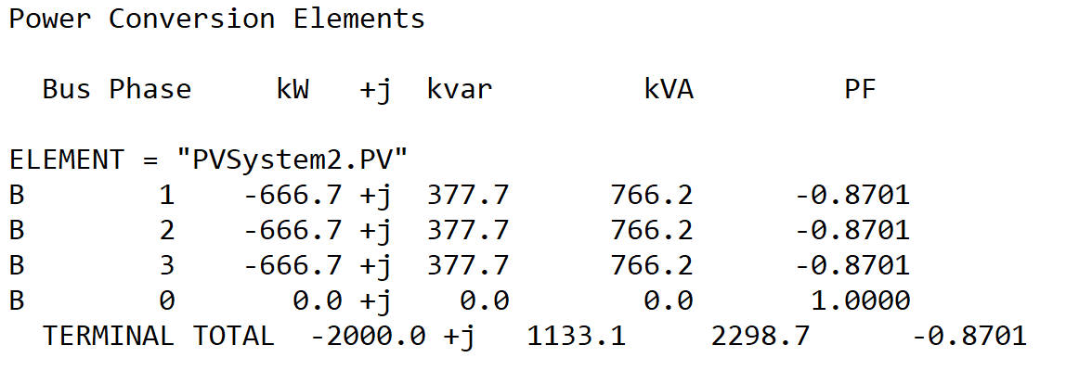
Scenario 5: Circuit’s bus is Monitored for volt-var. Average Voltage
OpenDSS code (mon_voltage_average-2.dss)
Vpu = Vpu_average = 1.0236049
Volt-var equation
Q= (-20 x Vpu +20) x kvarlimit = -1133.0355
Kvarlimit=kVA=2400

Slide 7
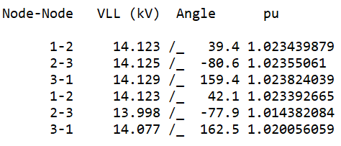
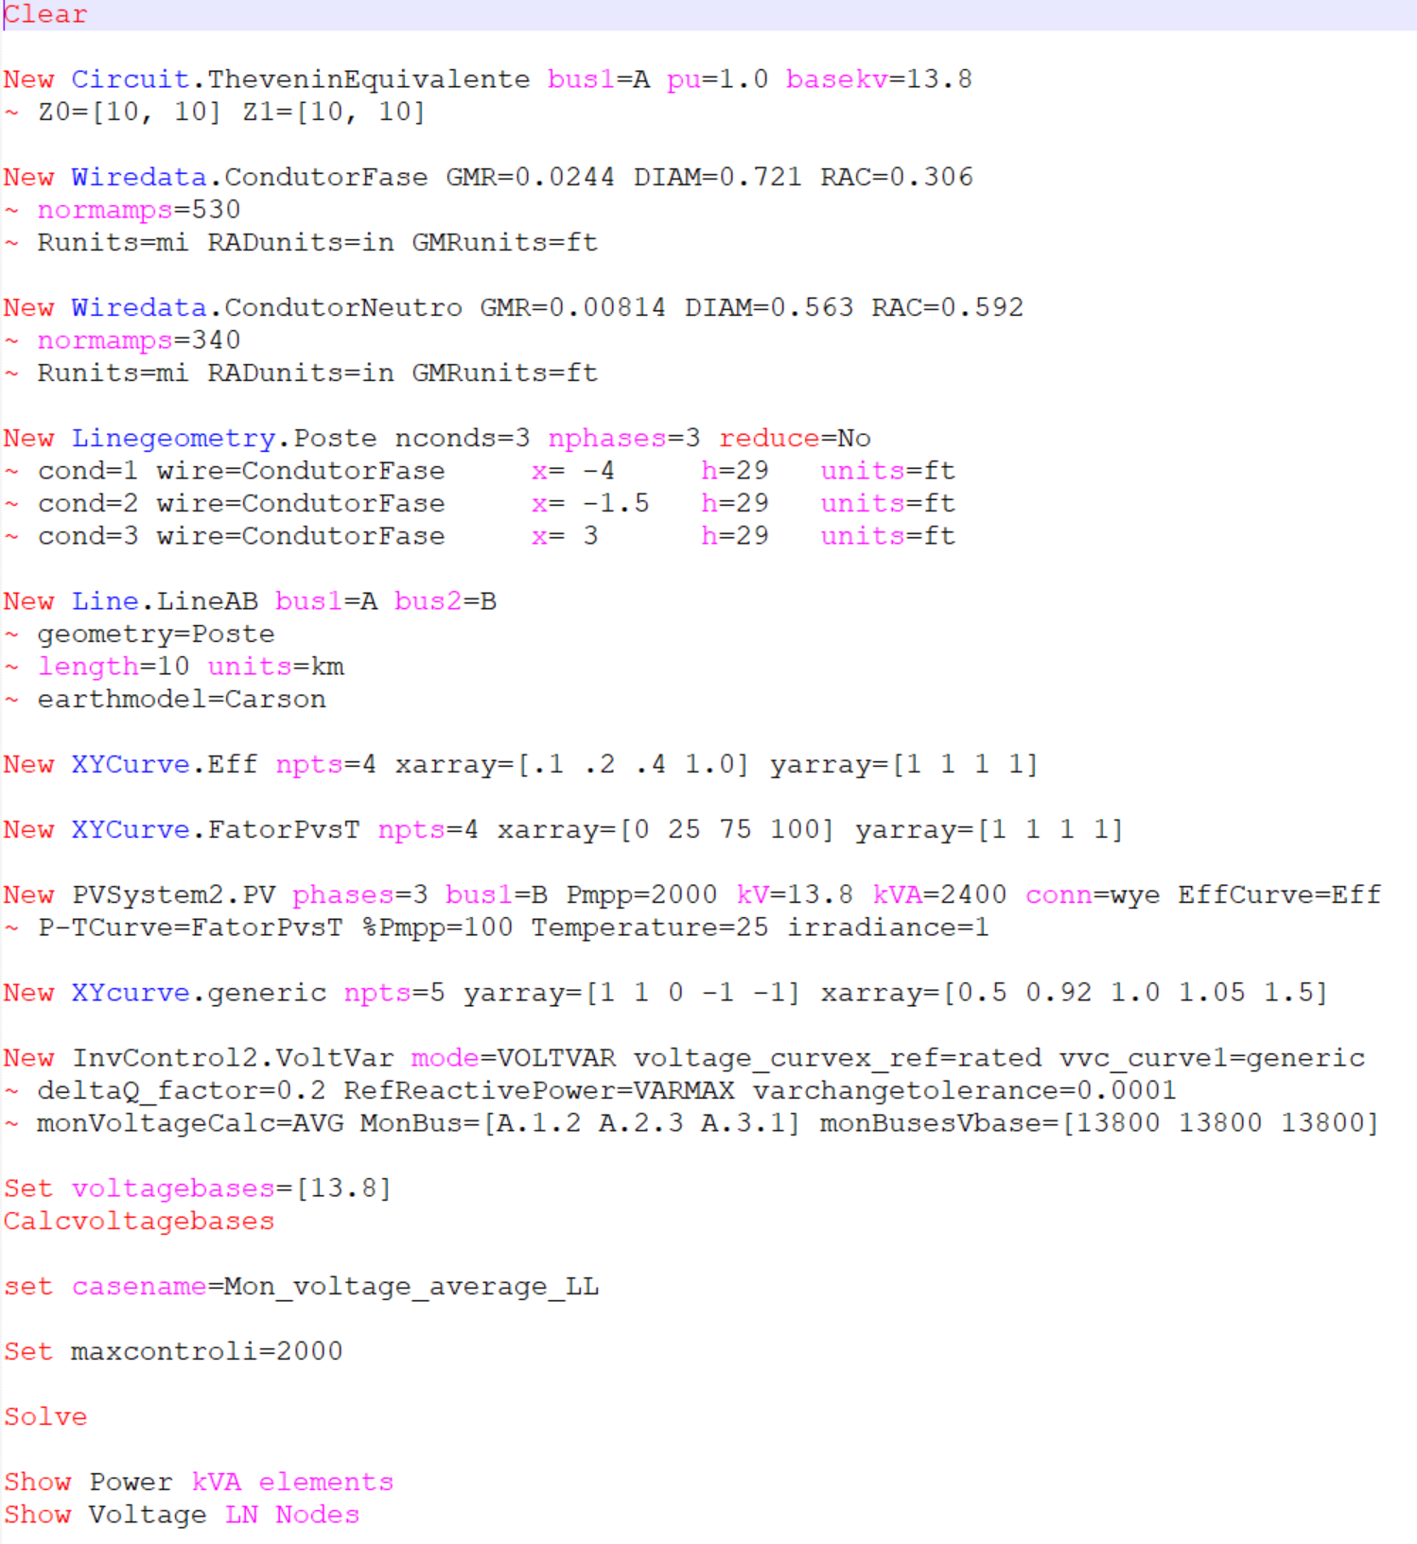
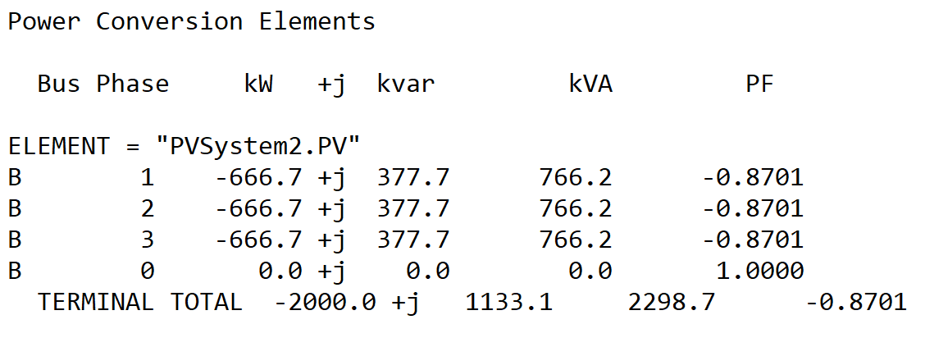
Scenario 6: Circuit’s bus is Monitored for volt-var. Average Voltage (LL)
OpenDSS code (mon_voltage_average_LL-2.dss)
Vpu = Vpu_average = 1.0236048
Volt-var equation
Q= (-20 x Vpu +20) x kvarlimit = -1133.032
Kvarlimit=kVA=2400

Slide 8
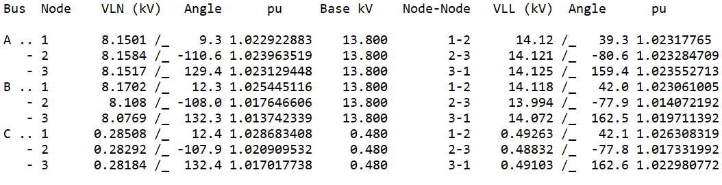
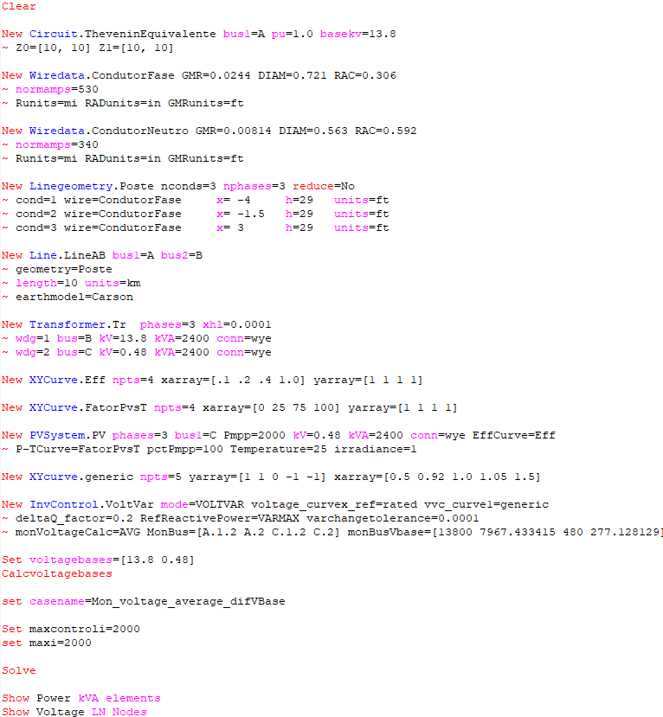
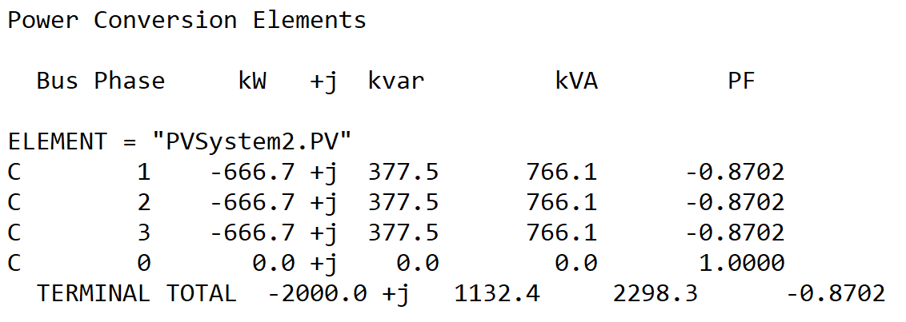
Scenario 7: Mix of phases and buses monitored. Average Voltage.
OpenDSS code (Mon_voltage_average_Mix-2.dss)
Vpu = Vpu_average = 1.023589755
Volt-var equation
Q= (-20 x Vpu +20) x kvarlimit = -1132.308
Kvarlimit=kVA=2400

Slide 9
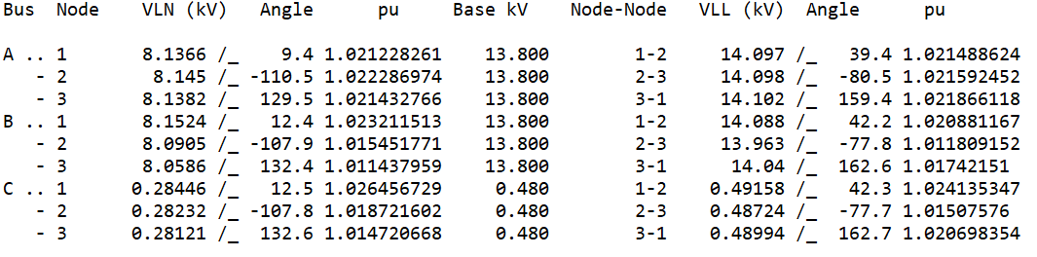
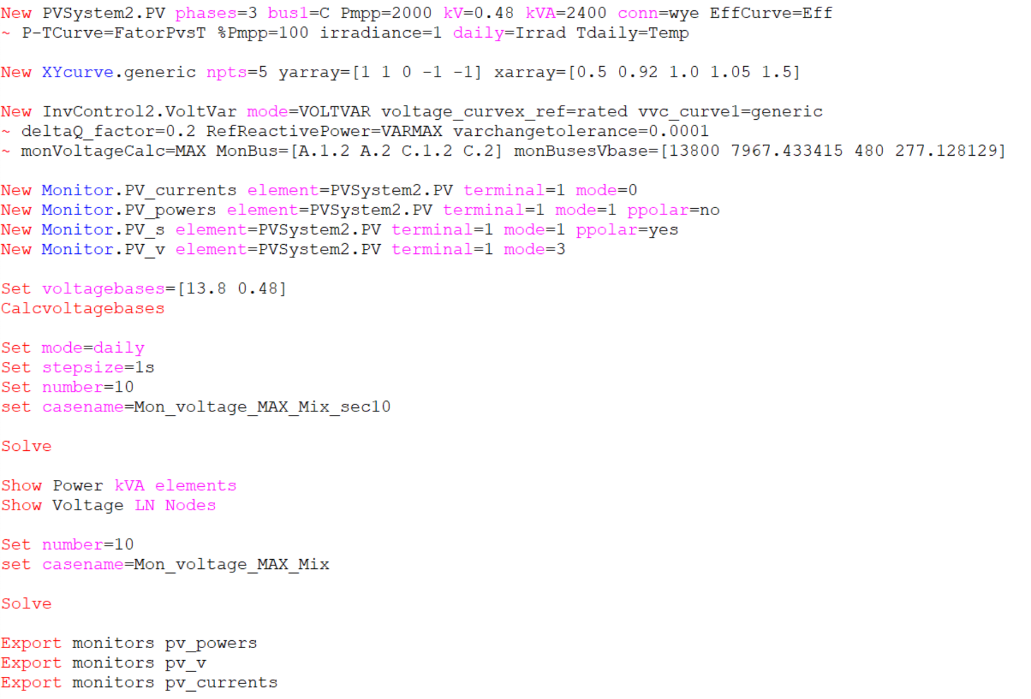
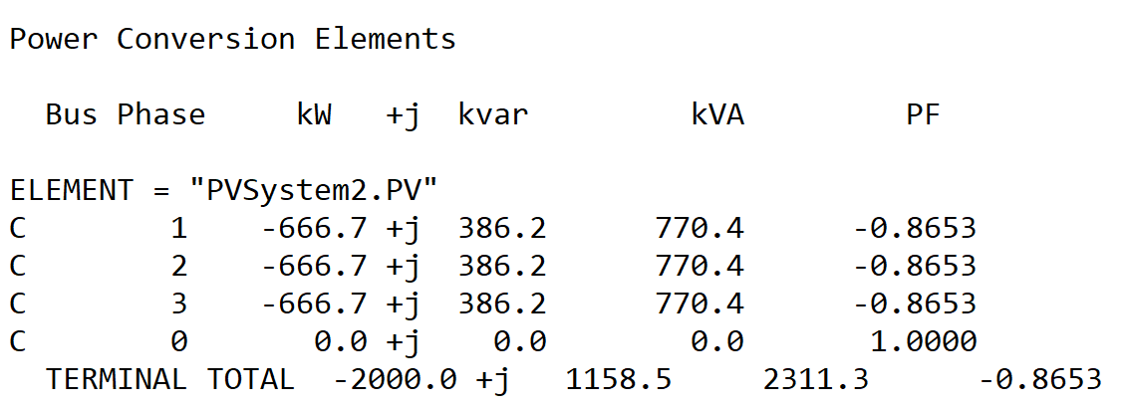
Scenario 8: Mix of phases and buses monitored. Max Voltage.
Results for Second 10
OpenDSS code (Mon_voltage_MAX_Mix-2.dss)
Vpu = Vpu_max = 1.024135347
Volt-var equation
Q= (-20 x Vpu +20) x kvarlimit = -1158.49
Kvarlimit=kVA=2400

Slide 10
Scenario 8: Mix of phases and buses monitored. Max Voltage.
Results for Second 10
Vpu = Vpu_max = 1.024135347
Volt-var equation
Q= (-20 x Vpu +20) x kvarlimit = -1158.49
Kvarlimit=kVA=2400

Slide 11
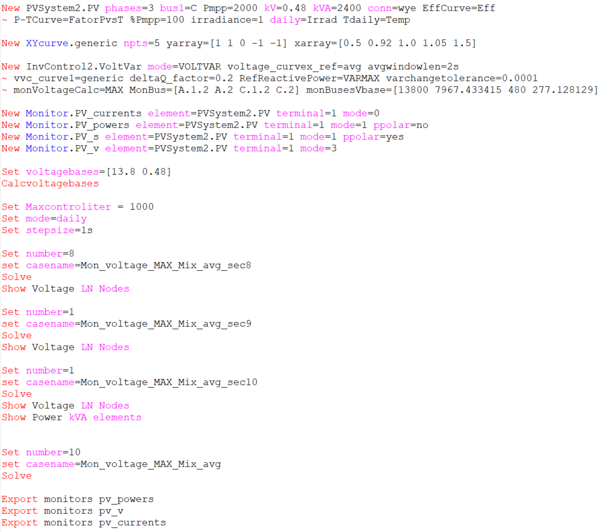
Scenario 9: Mix of phases and buses monitored. Max Voltage with voltage_curvex_ref=avg
OpenDSS code (Mon_voltage_MAX_Mix_avg-2.dss)

Slide 12
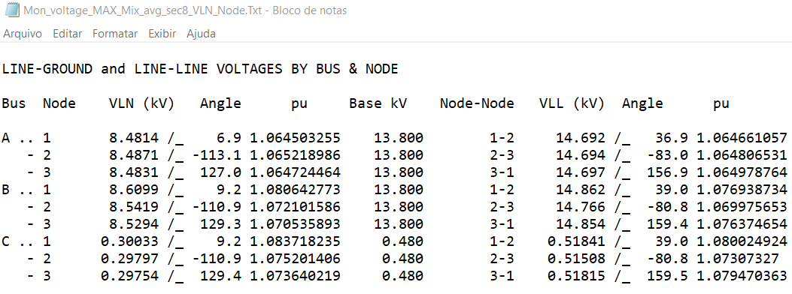
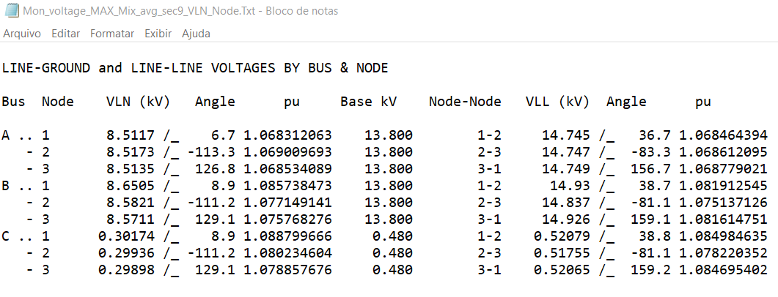
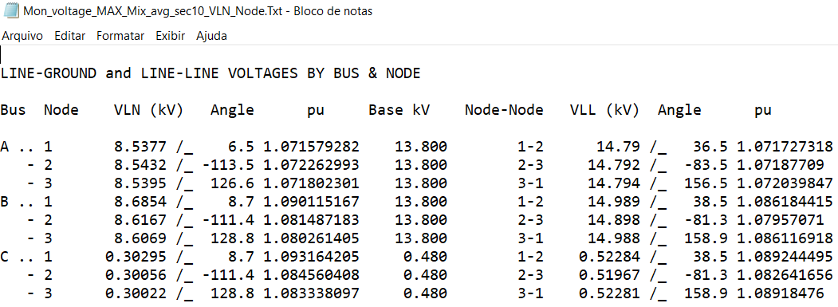
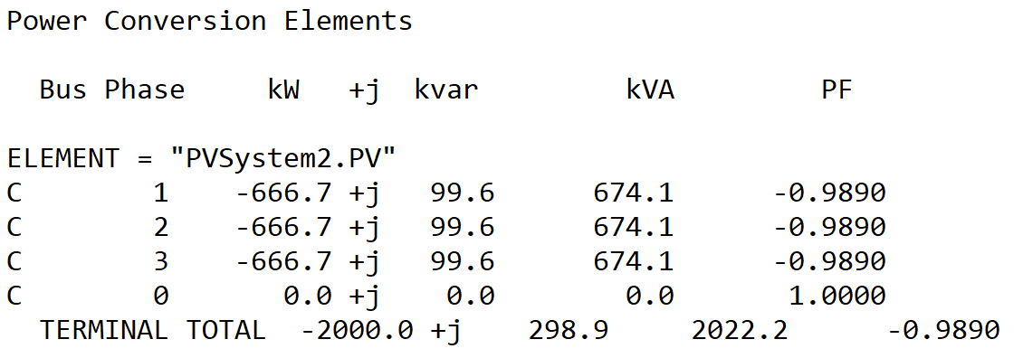
Scenario 9: Mix of phases and buses monitored. Max Voltage with voltage_curvex_ref=avg
Results for Second 8
Vpu_8 = Vpu_max_8 = 1.080024924
Vpu_9 = Vpu_max_9 = 1.08498635
Vpu_10 = Vpu_max_10 = 1.089244495
Vpu_avg_8-9 = (Vpu_8 + Vpu_9)/2 = 1.0825056
Vpu = Vpu_10/ Vpu_avg_8-9 =1.0062252
Results for Second 9
Volt-var equation
Q= (-20 x Vpu +20) x kvarlimit = -298.8096
Kvarlimit=kVA=2400
Results for Second 10
Results for Second 10

Slide 13
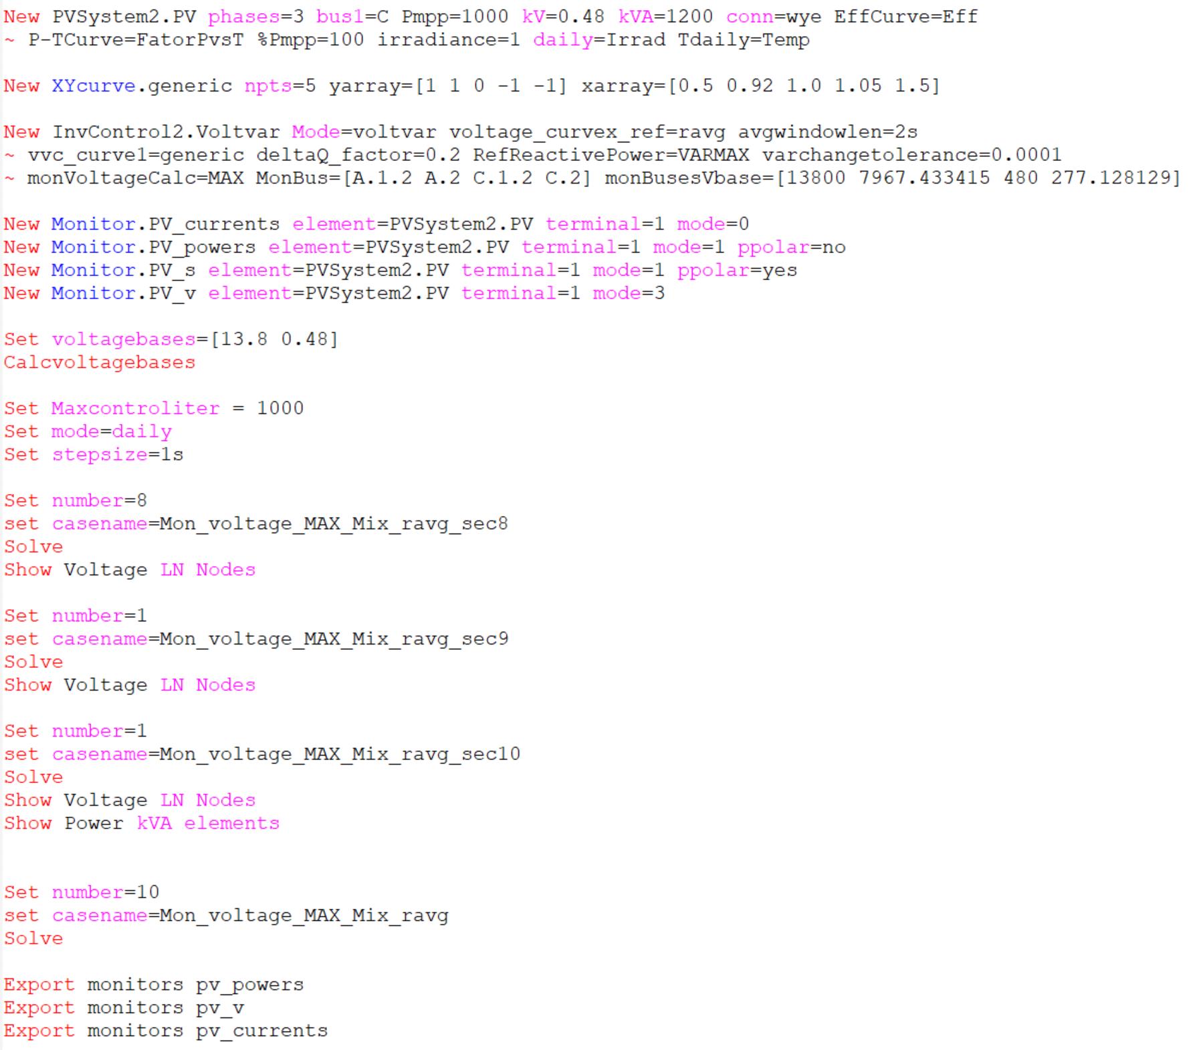
Scenario 10: Mix of phases and buses monitored. Max Voltage with voltage_curvex_ref=ravg
OpenDSS code (Mon_voltage_MAX_Mix_ravg-2.dss)

Slide 14
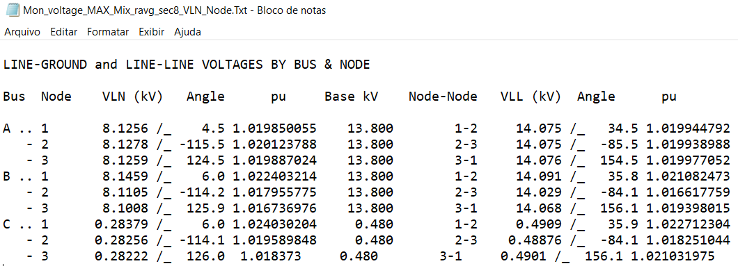
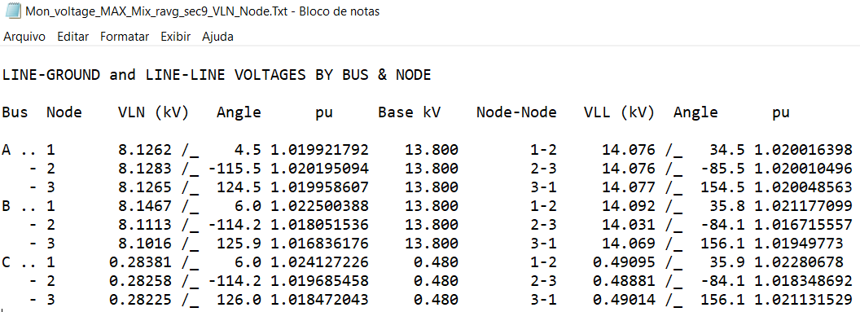
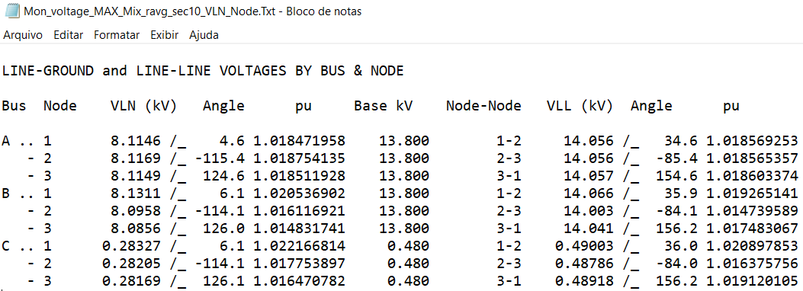
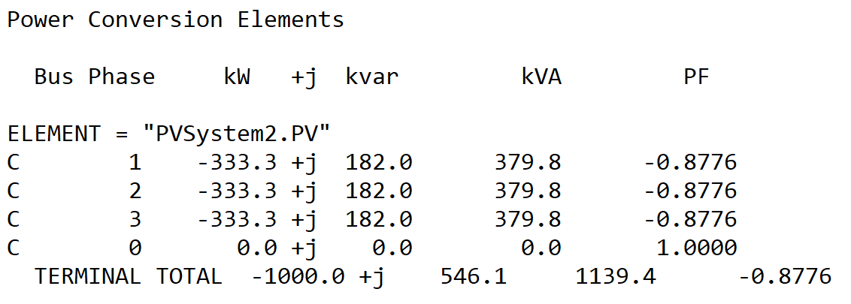
Scenario 10: Mix of phases and buses monitored. Max Voltage with voltage_curvex_ref=ravg
Results for Second 8
Vpu_8 = Vpu_max_8 = 1.022712304
Vpu_9 = Vpu_max_9 = 1.02280678
Vpu_10 = Vpu_max_10 = 1.020897853
Vpu_avg_8-9 = (Vpu_8 + Vpu_9)/2 = 1.022759542
Vpu = Vpu_avg_8-9 =1.022759542
Results for Second 9
Volt-var equation
Q= (-20 x Vpu +20) x kvarlimit = -546.229
Kvarlimit=kVA=1200
Results for Second 10
Results for Second 10

Slide 15
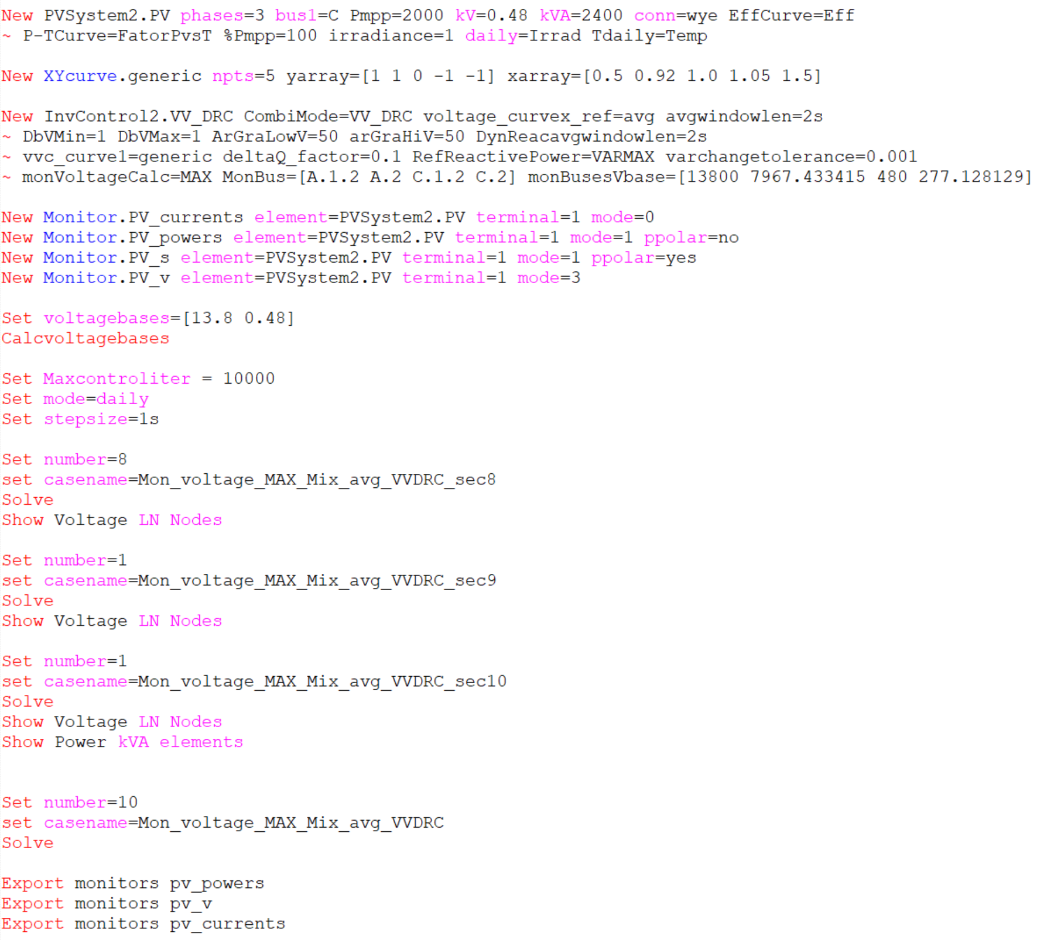
Scenario 11: Mix of phases and buses monitored. Max Voltage with voltage_curvex_ref=avg (VV_DRC)
OpenDSS code (Mon_voltage_MAX_Mix_avg_VVDRC-2.dss)

Slide 16
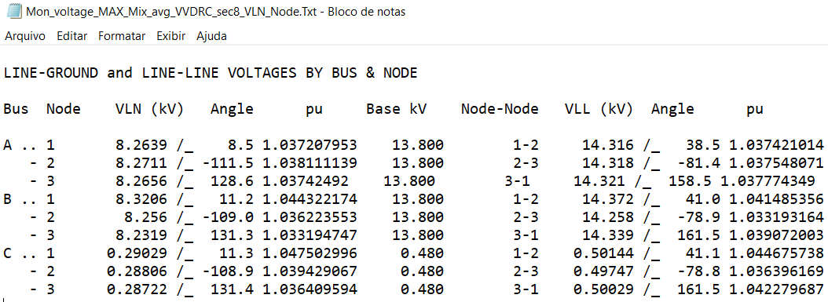
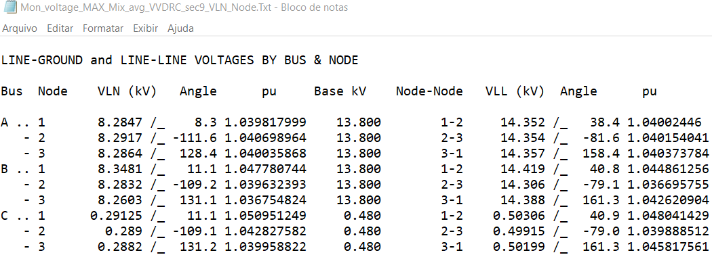
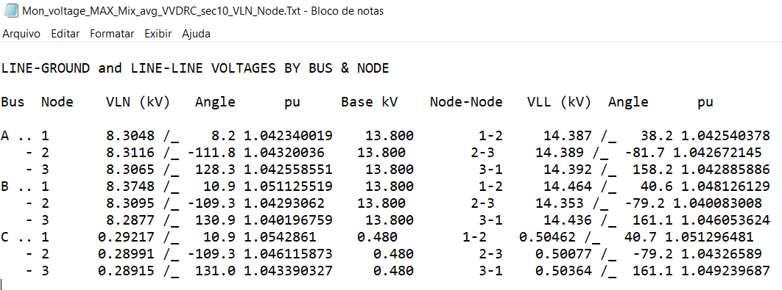
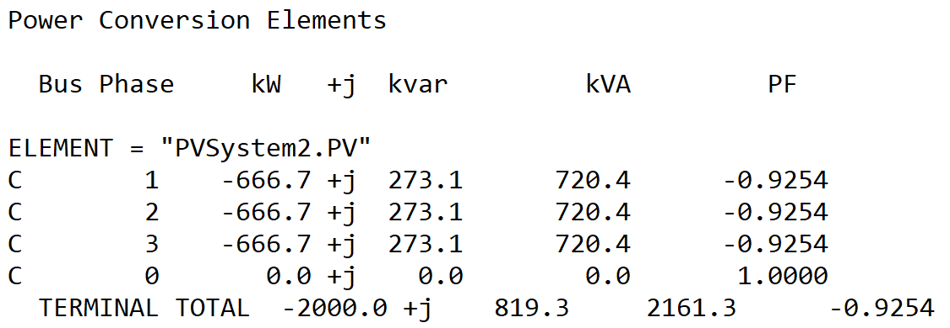
Scenario 11: Mix of phases and buses monitored. Max Voltage with voltage_curvex_ref=avg (VV_DRC)
Results for Second 8
Vpu_8 = Vpu_max_8 = 1.044675738
Vpu_9 = Vpu_max_9 = 1.048041429
Vpu_10 = Vpu_max_10 = 1.051296481
Vpu_avg_8-9 = (Vpu_8 + Vpu_9)/2 = 1.046358584
VpuVV = Vpu_10/Vpu_avg_8-9 = 1.004719126
DeltaVpuDRC = Vpu_10 - Vpu_avg_8-9 = 0.004937897
Results for Second 9
Volt-var equation
QVV= (-20 x VpuVV +20) x kvarlimit = -226.518
DRC equation
QDRC = -50 x DeltaVpuDRC x kvarlimit = -592.5476
Kvarlimit=kVA=2400
Qtotal=-819.065
Results for Second 10
Results for Second 10

